Slide 1

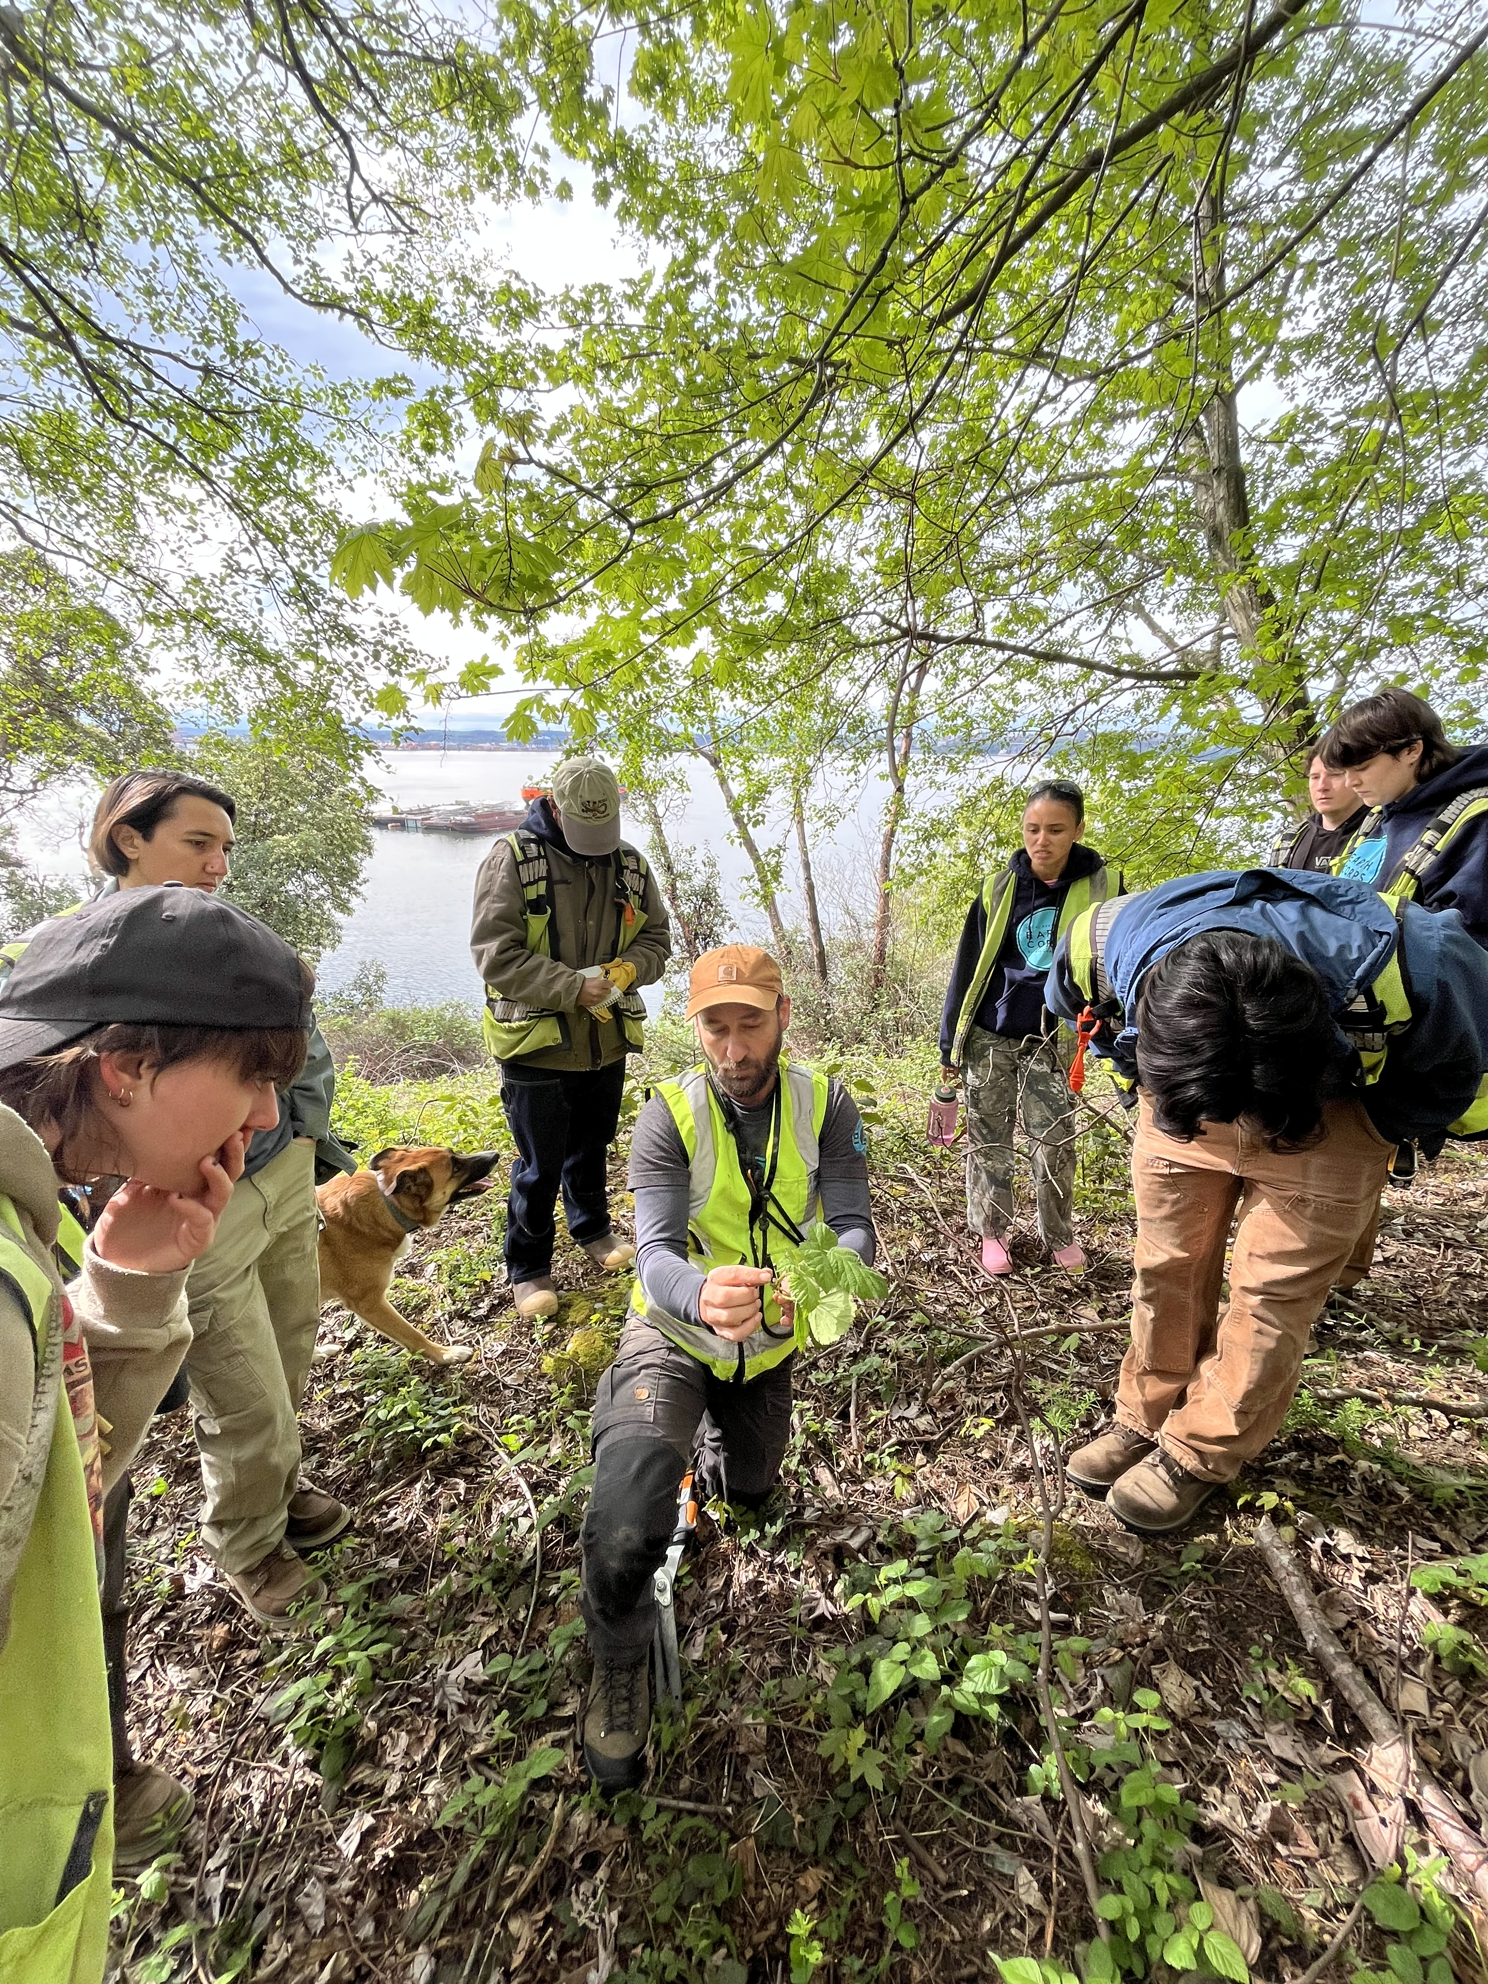
2026 ANNUAL GALA
Partner With Us to
Restore Land, Grow Leaders
& Build Community
Sponsorship Opportunities · $2,500 – $10,000 · Seattle, WA

Slide 2
WHO WE ARE
EarthCorps cultivates leaders and community partnerships to advance environmental justice.
RESTORE
GROW
BUILD
Restore Land
Grow Leaders
Build Community
& Climate Resilience
Forests, shorelines, wetlands, and watersheds restored using science-based practices that strengthen ecosystems and help communities thrive.
Paid service, hands-on skill-building, and intentional leadership development that prepares emerging environmental leaders for conservation careers.
Volunteer programs, partnerships, and shared learning that connect people to land and to one another for a more climate-resilient future.

Slide 3
2026 ANNUAL GALA
An evening of restoration, recognition, and community — bringing together
civic leaders, donors, partners, and the EarthCorps alumni network.
250–300
Seattle, WA
Oct 7, 2026
Guests
Location
Date
WHO ATTENDS
Major individual donors and philanthropic community
Civic and political leaders across the Puget Sound region
EarthCorps corpsmembers and alumni network
Corporate and nonprofit community partners

Slide 4
WHY PARTNER WITH EARTHCORPS
01
02
Visible Brand Alignment
Hands-On Employee Engagement
Associate your company with one of the Pacific Northwest's most respected environmental workforce development organizations — and with the people doing the work.
Title and Stewardship sponsors receive a branded corporate volunteer restoration day — a meaningful team-building experience with real ecological impact.
03
04
Year-Round Recognition
Mission Alignment
Sponsorship isn't just a gala night. Partners receive ongoing recognition in newsletters, social media, and our annual report throughout the year.
EarthCorps centers environmental justice — ensuring benefits reach communities that have experienced disproportionate environmental harm. Sponsorship is meaningful giving.
05
06
A 30-Year Track Record
A Room of Influence
EarthCorps has cultivated thousands of environmental leaders and restored hundreds of sites across the Puget Sound region. Your investment joins proven, lasting work.
250–300 civic leaders, philanthropists, and community partners — gathered around shared purpose. Gala sponsorship puts your organization at the table.

Slide 5
SPONSORSHIP TIERS
Restoration Champion
Stewardship Partner
Friend of EarthCorps
$10,000
$5,000
$2,500
2 Available
6 Available
8 Available
Included in our website and annual report as Restoration Champion
Reserved table of 8 at Rooted Fundraising Gala
Branded corporate volunteer restoration day
Your impact: Restoration Champions help support our international Corps program which brings international participants to EarthCorps to learn restoration and leadership skills alongside our American participants.
Included in our website and annual report as Stewardship sponsor
Reserved table of 8 at Rooted Fundraising Gala
Your impact: Stewardship partners help support field work and stewardship of the lands and waters of the Puget Sound to promote climate resilience and increase habitat health. This means better water quality, nutrient-rich soil less prone to erosion, and food and shelter for wildlife.
Included in our website and annual report as a Friend of EarthCorps
Two individual tickets
Your impact: Friends of EarthCorps help support EarthCorps’ Paid Youth Internship program. EarthCorps hosts interns from high schools primarily in South King County. Our interns are connected to the outdoors and exposed to green jobs as a possibility. This year, we’ve hosted a work along with our crews, a nature photography program in partnership with Seattle Art Museum, and a trip to the San Juan Islands.

Slide 6
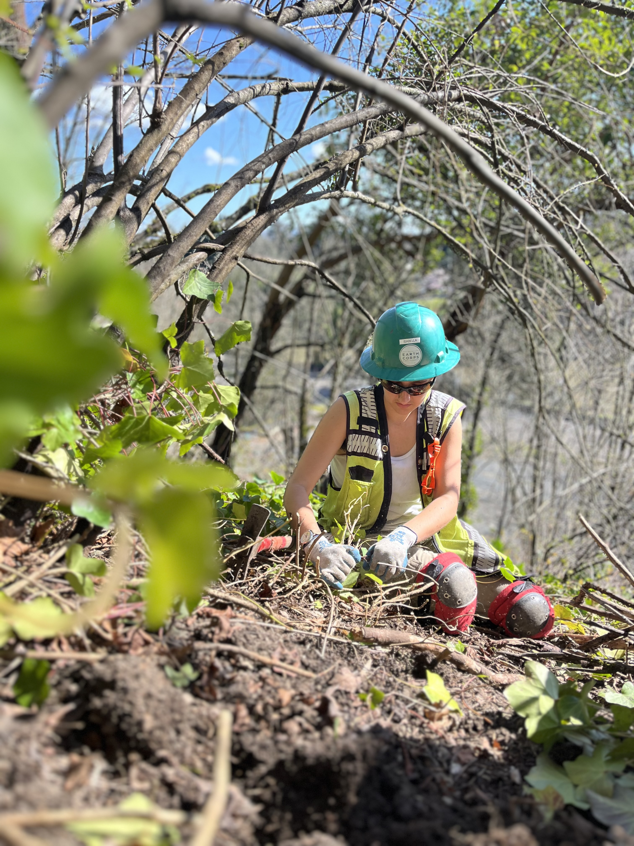
Join Us.
An equitable world where all people and nature thrive together — that's the EarthCorps vision. Your sponsorship helps us get there.
To reserve your sponsorship or learn more, please contact:
Kesia Cissé
Development Director · EarthCorps
kesia@earthcorps.org · 206-209-2342
earthcorps.org

